Slide 1
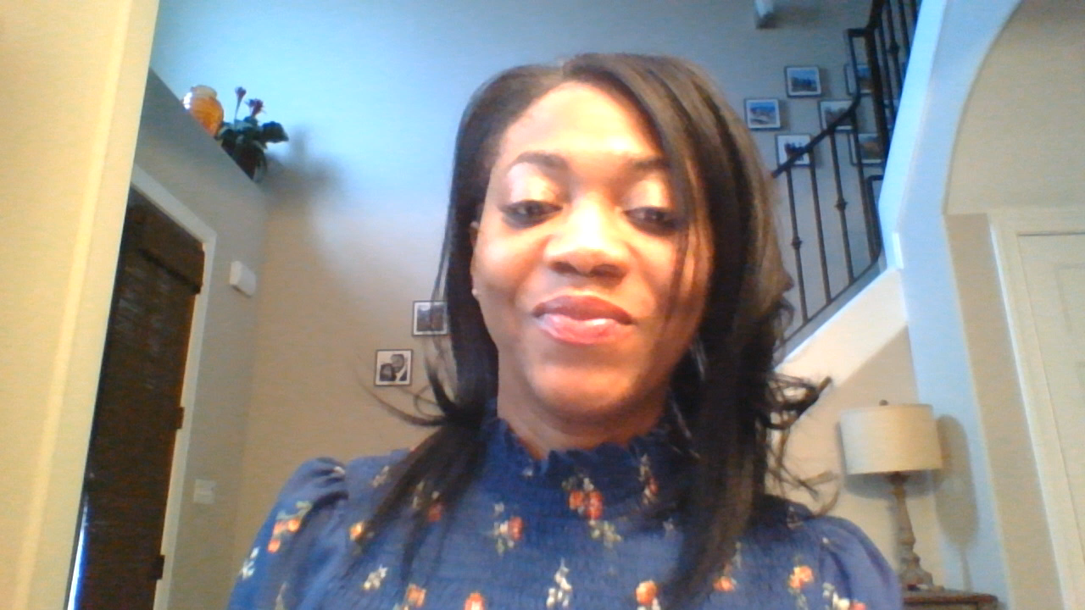
Lakessa Johnson
PLC Coach

Slide 2

Black History Month
Kamala Harris

Slide 3
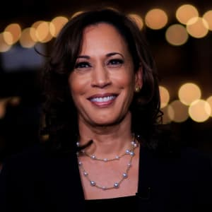
Kamala
Harris

Slide 4
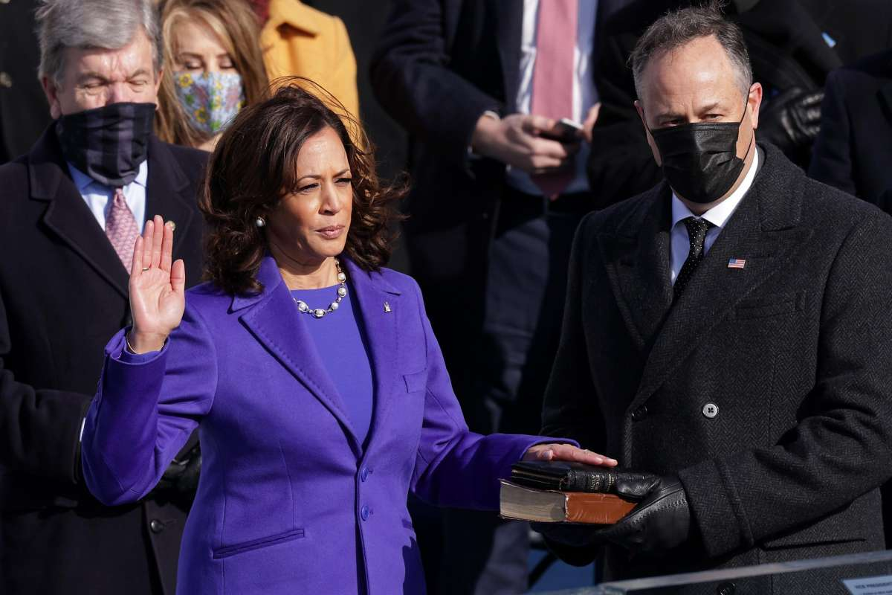
Kamala Harris is the vice president of the United States, making her the first female vice president and first Black person and Asian American to hold the position.

Slide 5
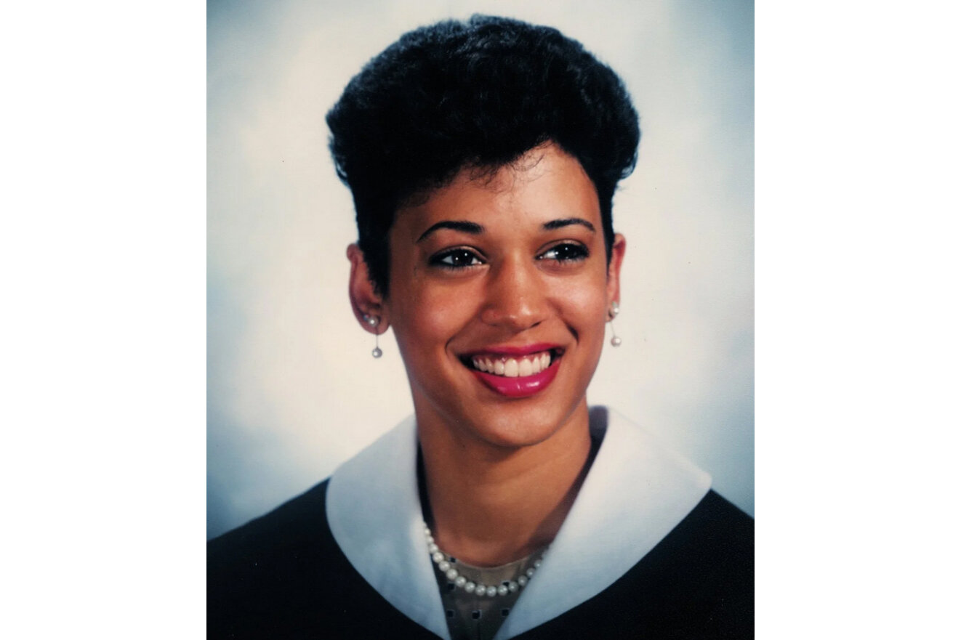
Kamala Harris was born on October 20, 1964, in Oakland, California. Reared in a predominantly African American neighborhood of Berkeley, she was brought to civil rights demonstrations as a toddler and sang in a Baptist choir.

Slide 6
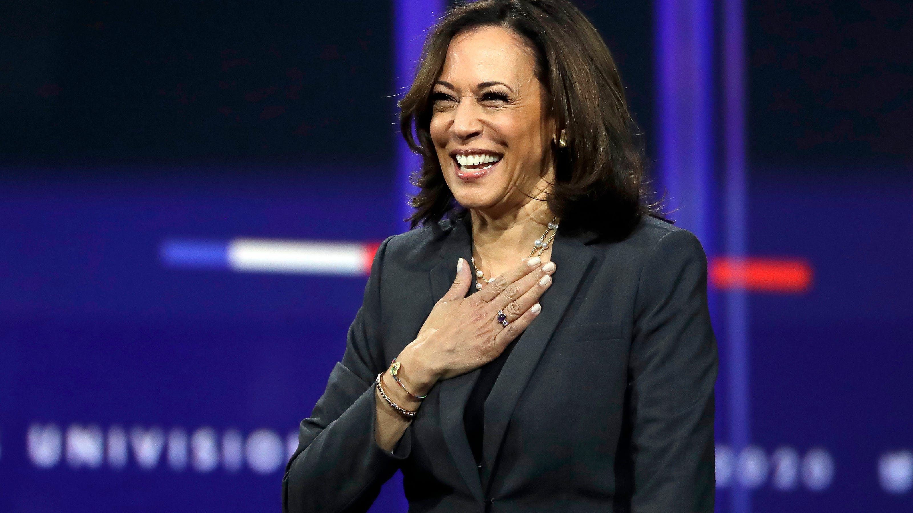
Harris attended Westmount High School in Quebec, where she founded a dance troupe with a friend. Returning to the States to enter Howard University in Washington, D.C., she was elected to the liberal arts student council and joined the debate team, en route to a B.A. in political science and economics. Harris then enrolled at the University of California, Hastings College of the Law, earning her J.D. in 1989.

Slide 7
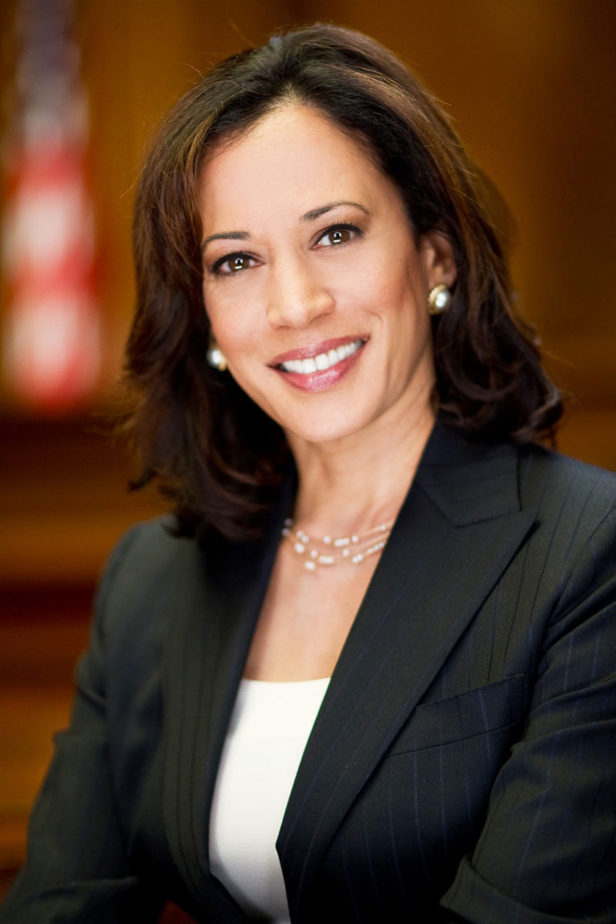
In November 2016, Harris handily defeated Congresswoman Loretta Sanchez for a U.S. Senate seat from California, thereby becoming just the second African American woman and the first South Asian American to enter the Senate.

Slide 8
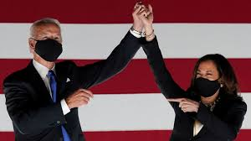
On November 7, 2020 four days after election day, Biden was declared as the 46th president-elect after winning Pennsylvania, making Harris the first female vice president and first Black person and Asian American to hold the position.

Slide 9



